Slide 1


City Council Workshop
November 7, 2024
Ron Feldner, PE
Chief of Water Resources
Zack Hoffman, PE
Director of Stormwater
Stormwater Management Program (SWMP) Update

Slide 2

Agenda
Recent Rainfall Events (2024)
City’s Role & Responsibility
Stormwater Program Overview
Stormwater Program Funding
Questions & Discussion

Slide 3
Presentation Acronyms
FEMA – Federal Emergency Management Agency
GEFA – Georgia Environmental Finance Authority
M – Millions of Dollars $
MS4 – Municipal Separate Storm Sewer System
O&M – Operations & Maintenance
SPLOST – Special Purpose Local Option Sales Tax
SWMP – Stormwater Management Program
SWU – Stormwater Utility

Slide 4
Recent Rainfall Events

Slide 5
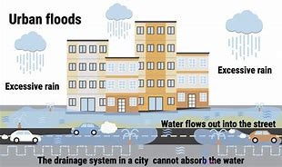
Urban Flooding: Very Likely in Savannah Large amount of rain occurs very quickly and locally
Heavy rainfall overwhelms the storm drains in the streets then flows into the canals, rivers, etc.

Slide 6
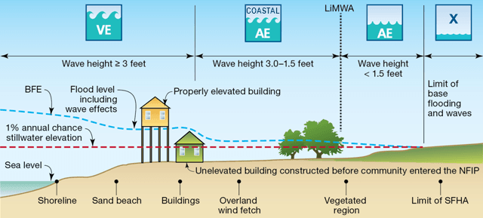
Coastal Flooding: Increasing Frequency Very high tide from astronomical event or tropical storm.
Tidal waters flow back into storm drains near the ocean, marsh, and tidal rivers.

Slide 7
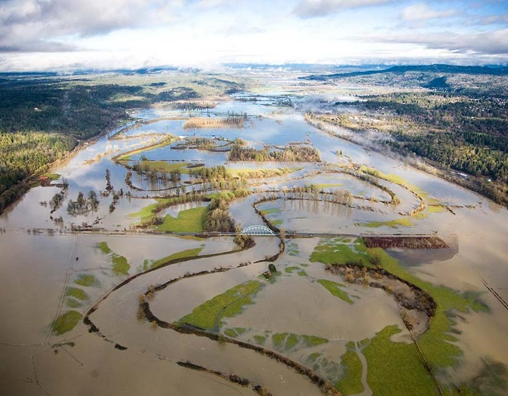
Riverine Flooding: Infrequent in Savannah Heavy rainfall over a large upstream watershed
River water expands beyond its banks, fills the floodplains, and flows back into storm drains systems.

Slide 8
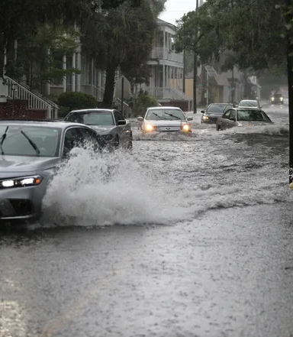
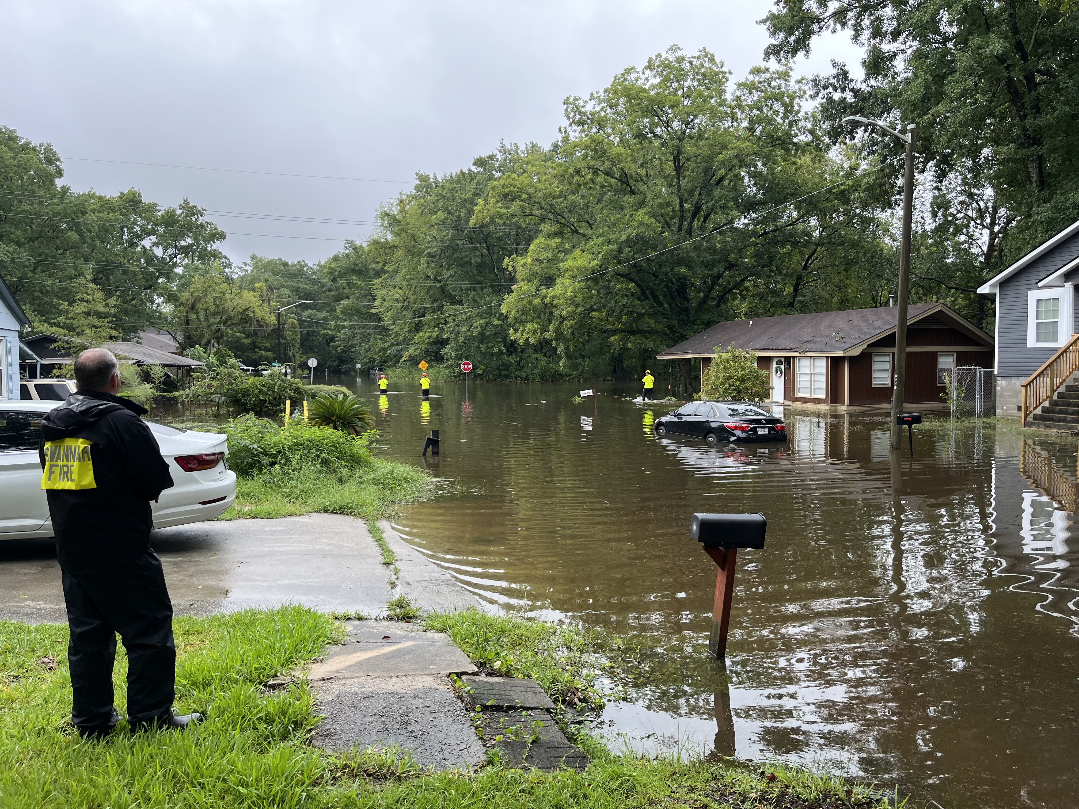
2024 Urban Flooding Events
Select Events:
July 20, 2024 – 2.8 inches in 4 hours
July 22, 2024 – 3.6 inches in 3 hours
Aug 20, 2024 – 3.1 inches in 1 hour
Result:
Urban Stormwater Flooding
Causes:
Rainfall rate (inches/hour)
Undersized infrastructure
Drainage system maintenance needs
Tide cycles (i.e. heavy rain during high tide cycle)
Whitaker Street
Tremont Park

Slide 9
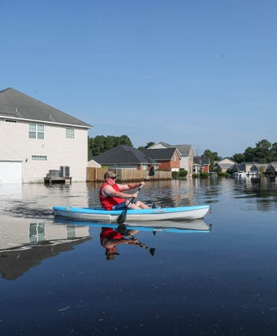
2024 Riverine Flooding Event (T.S. Debby)
Rainfall Data
10 inches in 48 hours*
Results:
Urban Flooding
Riverine Flooding
Causes:
Heavy rainfall in the Ogeechee River Watershed
Canoochee River flooding
Development within the floodplain
Dunnoman Dr and Grayson Ave
Bradley Pointe Subdivision

Slide 10
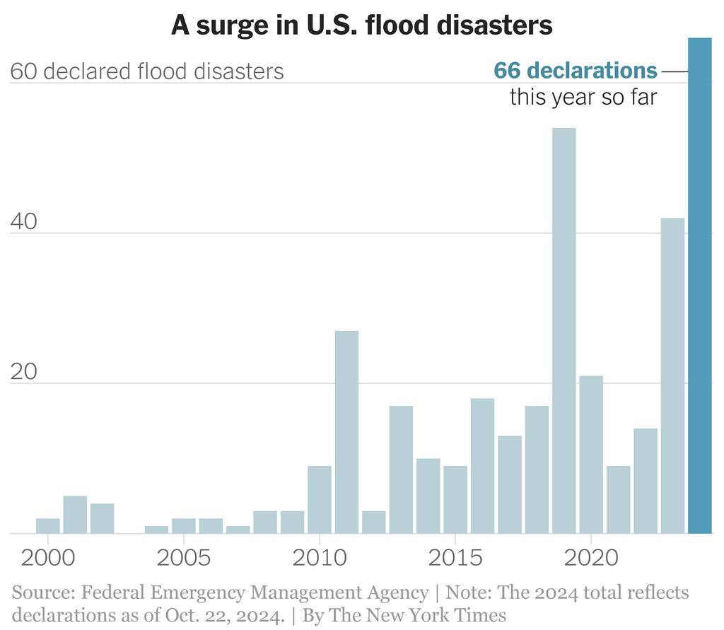

Slide 11
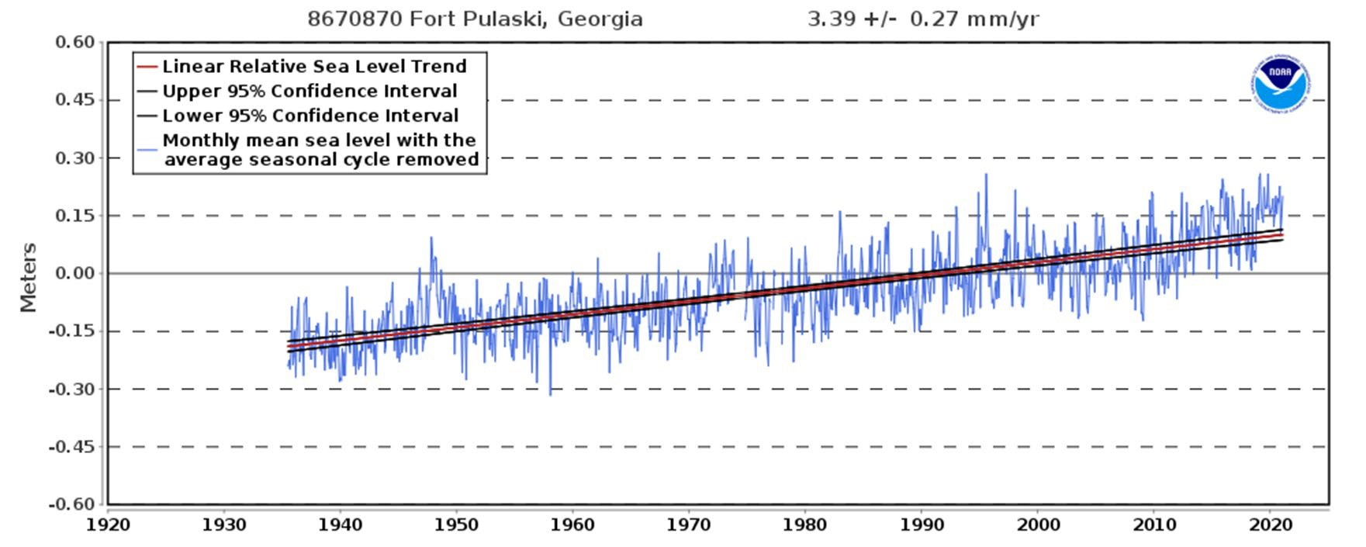
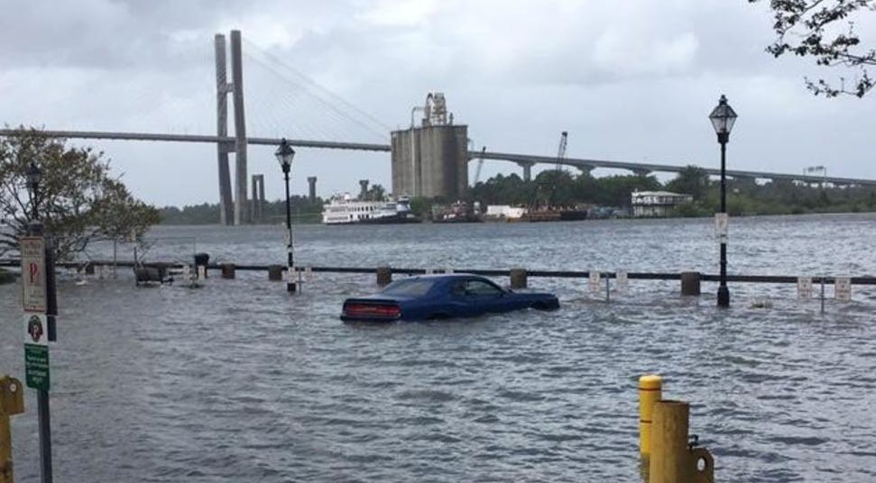
Drainage System Resiliency
Issues
Storm Surge
Sea Level Rise (~1 foot since 1940)
Mitigation Measures
Pump Stations
Tide Gates
Berms, Dikes, Sea Walls
Design Standards

Slide 12
City SWMP Role & Responsibilities

Slide 13
City SWMP Service Delivery Responsibilities
Drainage System Operations, Maintenance, and Repair
Regulatory Compliance activities required by the State and Federal Governments
Capital Improvement Program for Flood Control, Drainage Conveyance, and Water Quality

Slide 14
Stormwater Program Overview

Slide 15
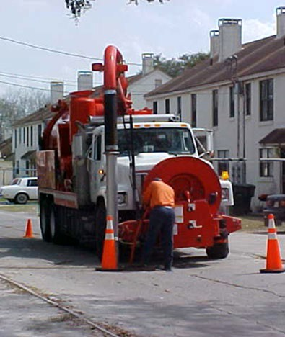
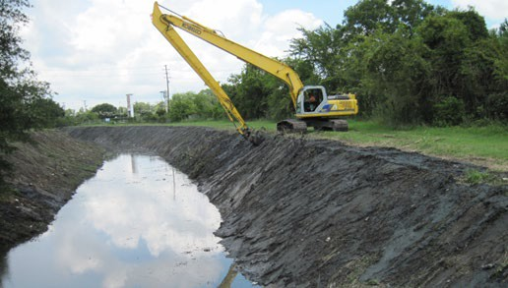
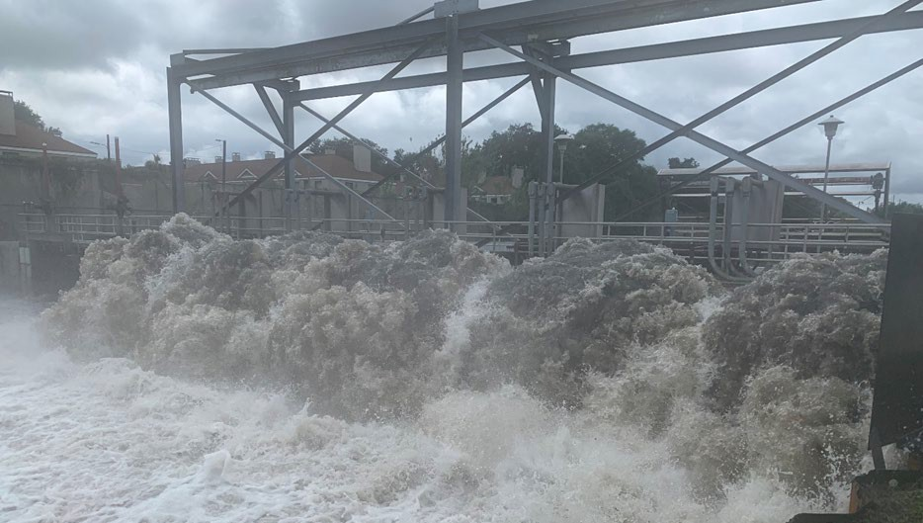
City of Savannah Drainage System Data
416.16 miles of pipe (closed system)
147.37 miles of ditches/canals (open system)
7 pump stations
6 stormwater detention ponds
31 tide gates
14,620 inlets
6,423 manholes

Slide 16
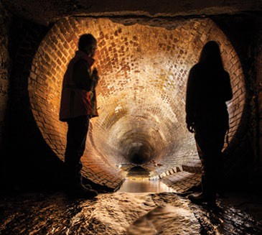
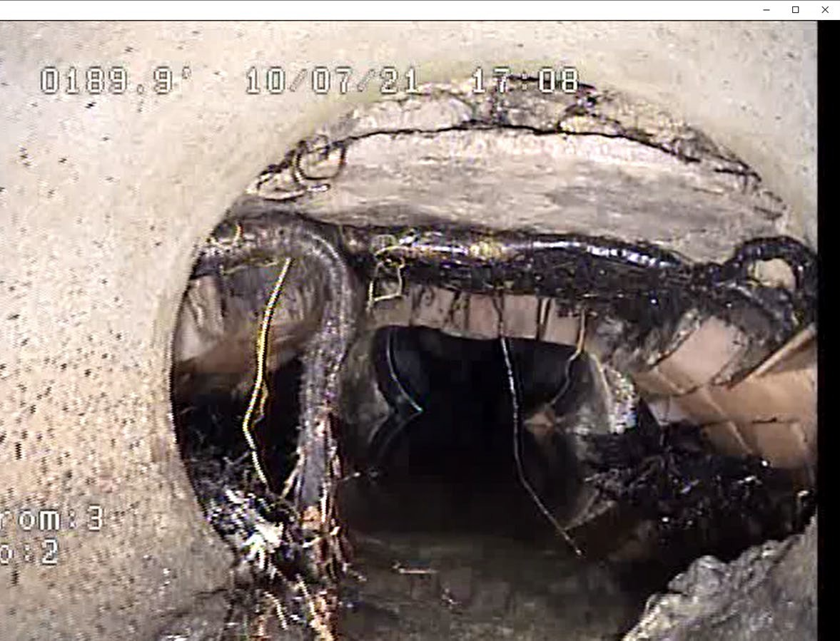
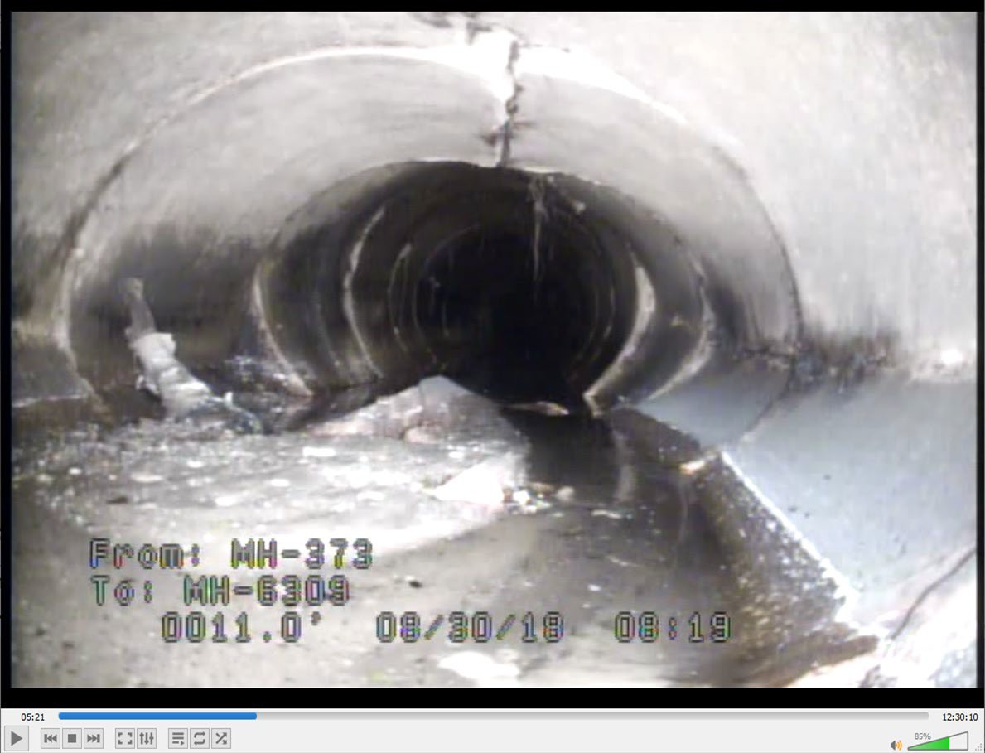
System Expansion
System Age
Climate Impacts
Capacity Challenges
City Drainage Infrastructure Issues

Slide 17
Stormwater Department
Work Order Statistics (2024)
Total Reports to Date: 141
Total Reports Open: 41
Total Reports Closed:100
Average Time to Close: 48 Days
Fastest Closed Request Type:
Broken Storm Sewer Top/Lid
Slowest Closed Request Type:
Stormwater Cave In
Most Common Request Type:
Clogged Storm Drain

Slide 18
Capital Improvement Projects (5 to 20 year) Flood Studies/ Masterplan
Stormwater Pump Station Improvements
12 Projects
Total Cost: $46.6 Million (Funded at $16.25 Million)
Localized Stormwater Infrastructure Construction Improvements
13 Projects
Total Cost: $22.3 Million (Funded at $4.01 Million)
Stormwater Yearly Capital Programs and Repairs
3 Projects
Total Cost: $2 Million/Year (90% Funded Annually)
Flood Study Modeling and Basin Studies
14 of 24 Basins Remain to be Modeled
Total Cost : $1.4 Million (Funded at $150,000 Annually)
Drainage Basin Stormwater Infrastructure Construction Improvements
25 Projects
Total Cost: $330 Million (Funded at $135 Million)
Total Funding Need: $402.3M
Total Funding Secured: $157.2M (or 39%)

Slide 19
Stormwater Program Funding

Slide 20
City Utility Operation & Funding Overview
City Operates Three “Pipe Systems”
(1) Water, (2) Sewer, and (3) Stormwater Pipes
Water & Sewer fees provide dedicated funding for the first two pipe systems
Third pipe system (Stormwater) does not have a dedicated funding source
Funding Opportunity for Stormwater System
SWMP Funding similar to Water & Sewer Funding
Develop comprehensive, dedicated funding strategy

Slide 21
City SWMP Funding Strategy
Current Capital Project Funding Sources
General Fund Revenues
SPLOST
Federal and State Grant Funding
Public-Private Partnerships
Potential Future Funding Mechanisms
Stormwater Utility User Fee Revenues
Amortized Funding (Bonds, GEFA Loans)

Slide 22
Stormwater Utility Overview
Functions as a user fee-based system similar to other City utilities (water, sewer, sanitation)
User fee revenues dedicated to the City SWMP budget
Customer user fee bill amount based on runoff contribution & service delivery

Slide 23
Stormwater Utility Overview
Assigns SWMP Costs to Parcels in an Equitable Manner
Impervious area stormwater runoff
Increased runoff = Increased service delivery demands
Stable/Consistent/Dedicated Annual Revenue Stream
Funds all stormwater services (O&M, Capital, etc)
Revenues can pay for bond and GEFA loans debt service as well as “City Match” for Grants
User fee credits offered for reduced runoff contribution and/or reduced service delivery demands
Notes:
23

Slide 24
Georgia Stormwater Utilities (SWUs)
How Many SWUs?
Nearby Georgia SWUs
First Georgia SWU -- Griffin, GA (1998)
Approximately 75 SWUs in 2024
Seven SWUs nearby to Savannah
City | Residential Rate/Month
Garden City | $4.75
Richmond Hill | $4.75
Brunswick | $5.25
Hinesville | $5.86
Augusta | $6.42
Statesboro | $5.00
Valdosta | $3.50
Notes:
24

Slide 25
Garden City SWU Customer Bills
Customer Examples | Billing Units | Stormwater User Fee/Month*
Single Family Residential | 1.0 | $4.75
Small Professional Office | 1.4 | $6.65
Fast Food Restaurant | 11.9 | $56.53
Bank Branch | 13.1 | $62.23
Hotel | 35.9 | $170.25
Institutional Building | 52.7 | $250.33
Truck/Container Storage Yard | 53.5 | $254.13
Retail Shopping Center | 66.9 | $317.78
Multi-Family Apartment Complex | 109.3 | $519.18
Large Industrial Warehouse | 344.4 | $1,635.90
* SWU fee with a billing rate of $4.75 per each 3,000 square feet of impervious area per month -- and before SWU credits have been applied.

Slide 26
SWU Funding Study Project Tasks
Procure Stormwater Utility Consultant – August 8, 2024
Develop Stormwater Education & Community Outreach Program
Conduct community outreach and gather citizen/customer input
Analyze historic and future SWMP Expenses
Establish Stormwater Management Cost Center & SWU Enterprise Fund
Assess historical, current, and future SWMP service delivery data
Evaluate SWMP program level of service and identify needed service delivery enhancements
Identity and develop potential SWMP funding strategies for O&M, Capital, etc
Future City Council decision on the path forward regarding SWMP Funding

Slide 27
Questions & Discussion

