Slide 1
Tourism Update
Walking Tours
January 15, 2025
Special Events, Film, and Tourism Department
City of Savannah

Slide 2
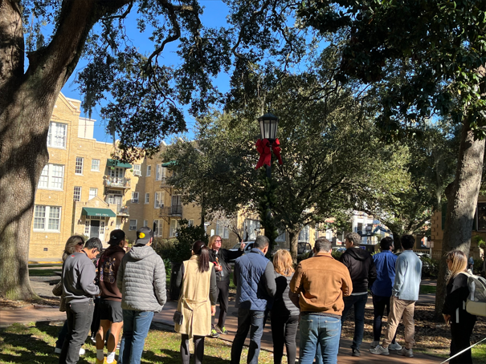
The Walking Tour Ordinance in Savannah regulates walking tours to ensure they are conducted safely and respectfully within the city. The ordinance needs updates to address growing concerns about noise, residential disturbances, and the viability of local walking tour companies.
Goal: Propose modifications to address these concerns while balancing
the needs of residents, walking tour businesses, and tour guides.

Slide 3
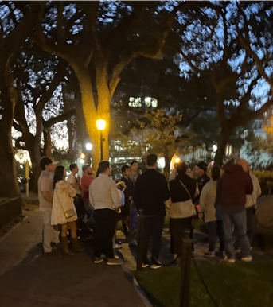
Walking Tours at a Glance
62 Registered Walking Tour Companies
250 (+-) Tour Guides
Potentially 45 Tours Offered after 10PM
Currently no “End Time” for tours – only small restricted area
30 Total number of Guests allowed per Walking Tour
No Voice Amplification Systems Allowed
Tour must not block sidewalks
Tours must not encroach on Private Property

Slide 4
Walking Tour Ordinance Modifications Challenges and Considerations
Resident Feedback
Noise in Residential Areas
Large Groups of People, particularly after hours
Resident Privacy
Tour Company Feedback
Impacts to Employees of Tour Companies
Small Business Vitality – Financial Impact
Visitor Experience
Current Rules on Tour Sizes

Slide 5
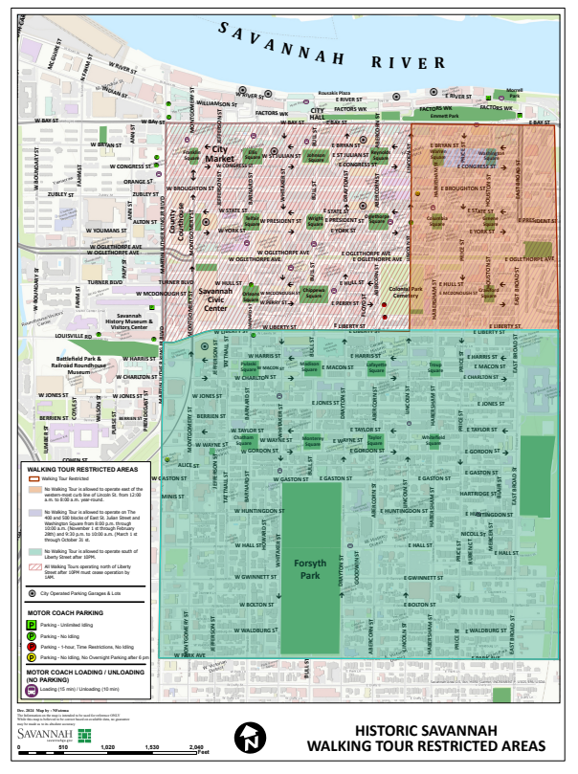
Initiate Pilot February 1, 2025, for 90 Days
  Includes “slower” Visitor Travel Month – February
  Longer Days – March 9, 2025, Spring Forward
  Busiest time for Visitor Travel – March and April
Restrict Walking Tours south of Liberty Street after 10PM
Maintain Current Group Size – avoiding potential revenue loss
Set cut-off time of 1AM for all Walking Tours

Slide 6
Impacted Locations and Squares
North of Liberty – Walking Tours allowed
between 10PM and 1AM
Chippewa Square
McDonough’s Restaurant
Six Pence Pub
Wright Square
Johnson Square
Savannah Civic Center
River Street
City Market
Broughton Street
Ellis Square
Colonial Cemetery
Franklin Square
Warehouse District
South of Liberty – No walking Tours
after 10PM
Madison Square
Sorrell Weed House – closes 11PM
Monterey Square
Mercer House – closes 5PM
Forsyth Park
Taylor Square
Lafayette Square
Chatham Square
Whitefield Square
Troup Square
Pulaski Square
Pinkie Master’s Bar
Cathedral of St. John the Baptist

Slide 7
Pilot Program Enforcement
Number of Citations w/in 30 Days | Fine
5 or more | $500
10 or more | $750
15 or more | $1,000
Enforcement of the Tour Service for Hire Ordinance will be in effect for the duration of the Pilot Program.
$100 Fine – Touring in Restricted Zones and Touring during Restricted Hours
Any tour service company or other business operating a tour whose operators receive five or more sustained citations for violating this article in a 30-day period shall be assessed additional fines.

Slide 8
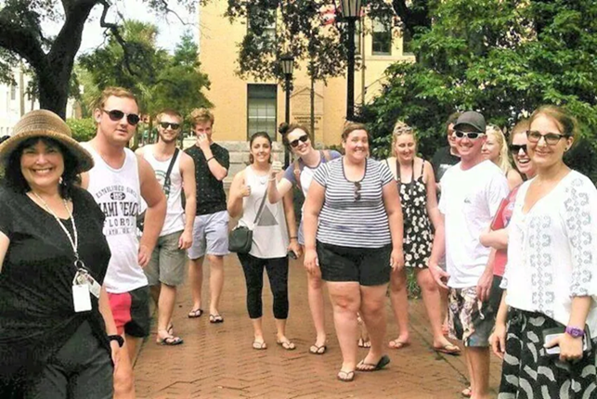
Pilot Program – Potential Impacts
Potential for fewer tours offered due to restriction south of Liberty Street after 10 PM.
Financial impact is minimal compared to a reduction in the number of guests per tour.
Tour operations more confined to the commercial district.
Possible increase in pedestrian congestion on streets in commercial areas after 10 PM.
Overall Balance: Provides relief to residents while allowing tour companies to maintain operations without significant financial strain.

Slide 9
tourism@savannahga.gov

