Slide 1

REVENUE DEPARTMENT
NOVEMBER 2023
QUARTERLY MEETING

Slide 2
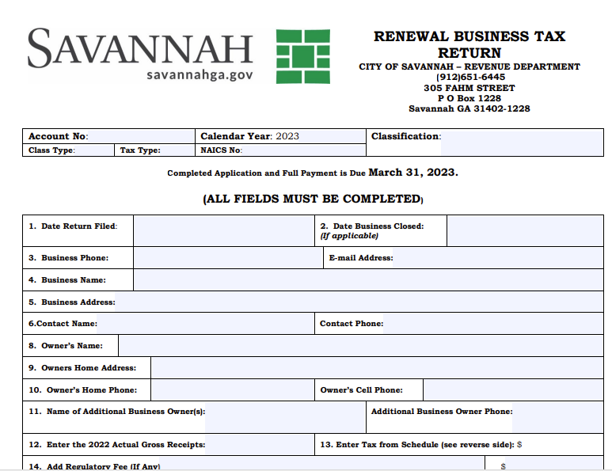
Business Tax Renewal
Business tax certificates expire on December 31 (in the year of issuance) and must be renewed annually by March 1 (of the year immediately following the year of issuance) to avoid penalties and interest.
Business Tax Renewal applications will be sent along with the Alcohol Renewal applications. You can also download a blank copy of the renewal form and view instructions for renewal.

Slide 3
Alcohol Licensing Renewal Timeline - 2024
Dec 15, 2023, Alcohol Renewals mailed out.
Dec 31, 2023, Alcohol licenses Expire
January 29, 2024, Completed, signed, and notarized documents including required fees due to Revenue Department by 5 pm
New alcohol requests and New Ownership requests must be processed through the Alcohol Review Committee
www.savannahga.gov/3589/Alcohol-Review-Committee
January 31, 2024, Renewal packets received after this day will be assessed a 25% penalty of the total annual fees.
All dispensing of alcoholic beverages must cease until a 2024 license is issued
Alcohol licenses will be mailed to the business location unless the applicant requests that the license be held by the Revenue Department for pickup. Alcohol Licenses will not be emailed.

Slide 4
Alcohol Licensing Renewal Requirements
Alcohol Insurance Submission
All alcohol businesses will be required to submit their annual business tax return along with a copy of Insurance Certificate with their alcoholic beverage renewal packet.
Sunday Sales Renewal
Businesses classified as Class C will be required to submit a Sunday Sales affidavit before the 2024 renewal alcohol application can be processed.
Sunday Sales affidavits must be signed by a certified accountant or accompanied by an accountant’s statement as to the type of review conducted to adequately verify the business meets the financial requirements for quality for Sunday Sales.​
Excise Tax
Additionally, all excise taxes (Mixed Drink, Hotel/Motel, etc.) must be current at the time of renewal. No alcoholic beverage license will be issued to a business if delinquencies exist.
Businesses classified as Class E will be required to submit Signatures of bookkeepers, tax preparers, or other financial service providers will not be accepted.
Establishments not meeting the requirements must cease sales of alcoholic beverages on Sundays.

Slide 5
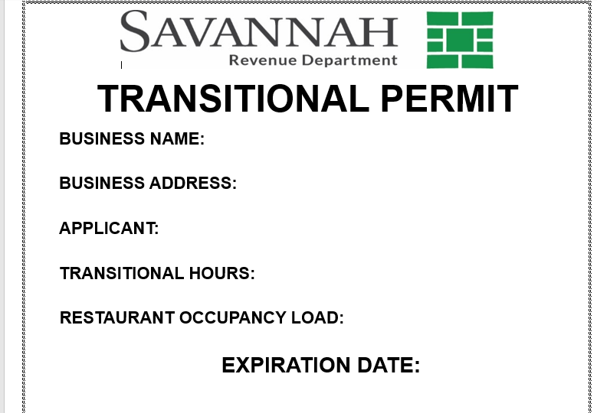
Transitional Permit
Transitional Permit (Class K) Code Section 6-1209 (w) (1-4). Transitional Permit Establish requirements for alcohol serving establishments that functionally transition from restaurants to bars, including ceasing food sales or charging entry fees,
Primarily late at night. No one under 21 years of age is allowed on premises during transitional hours. Only current ABL/Responsible
ABL applicants can apply for Transitional Permit. Additional Public Safety Plan must be turned into the SPD’s Alcohol Beverage
The Below establishments has been approved for Transitional (Class K) operations:
The Grove
800 East
Hideaway

Slide 6
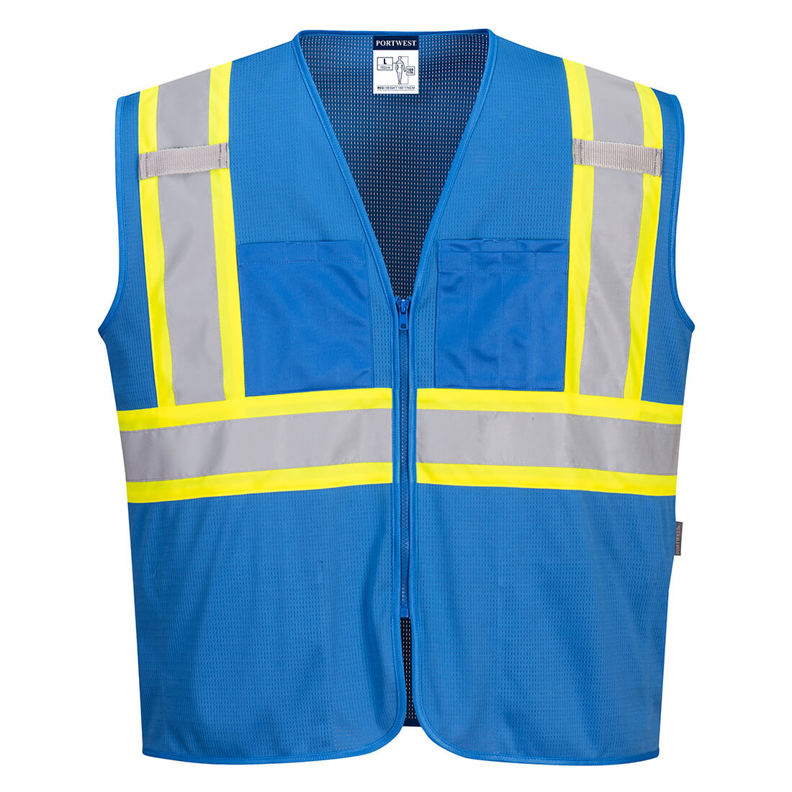

Field Awareness & Compliance Team Savannah -FACTS
FACTS Budget
FACTS Mission Statement
Our mission is to ensure operational compliance standards and procedures with non-alcohol and alcohol establishments in the City of Savannah limits.
FACTS goal is to establish the implementation and enhancement of work environment awareness to effectively contribute to the safety and support of our residents and visitors throughout the City of Savannah.
Members of this team will be identified with the blue vest above with the Deputy Marshal logo located on the back.
10- City of Savannah Employees
Overtime
Uniforms
4 – Revenue Staff
( 1 Manager, 1 Coordinator, 2 Revenue Investigators)
2- SPD (ABC Civilians)
2- Code Compliance Officers
2- Fire Marshalls

Slide 7
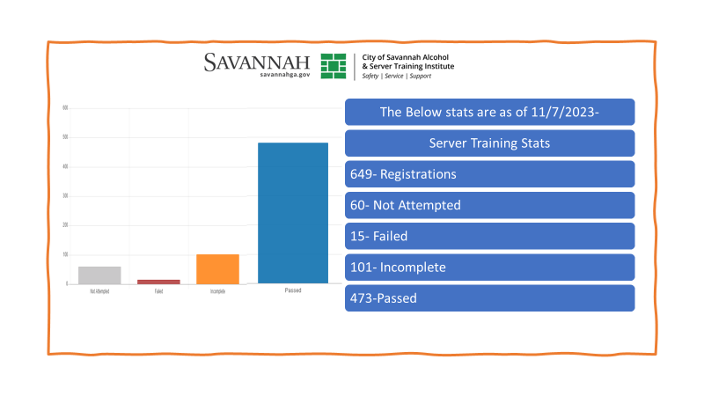

Slide 8
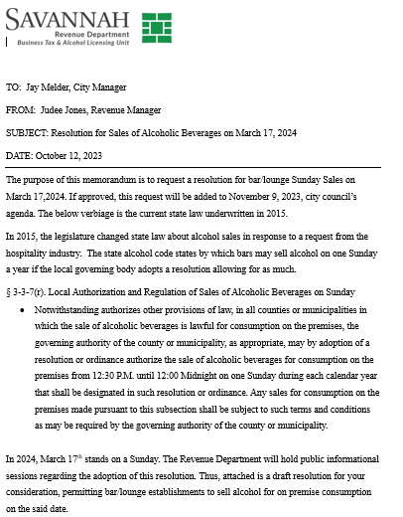
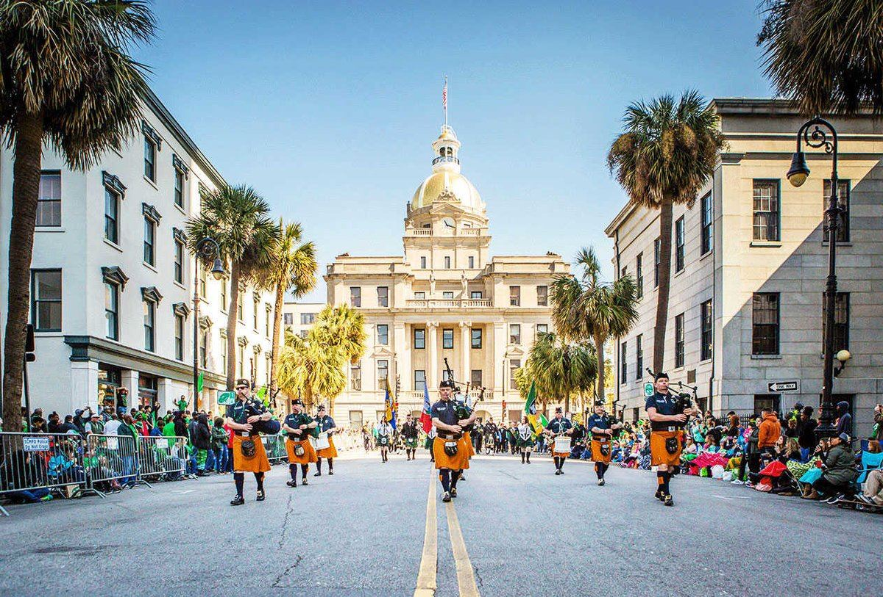
2024 Saint Patrick Resolution Sunday Sales
One of the largest and most anticipated celebrations in Savannah will have its 200th anniversary next year.

Slide 9

COAM- Coin Operated Amusement Machines
City of Savannah Step by Step Process
Once the Revenue Department receives notice from the COAM Data Analyst of the approved Master Class and Location for Class B Only, the Revenue Specialist will print and mail out a local certification to be mirrored as the same deadline for COAM Licensing.
The Alcohol Beverage Compliance Unit ( Savannah Police Department ) will monitor and enforce violations by partnering the COAM agents.
COAM Code Section can be found:
https://www.savannahga.gov/2737/Coin-Operated-Amusement-Machines
The COAM licensing application (www.gacoam.com) opens on May 1, 2023 (Monday) for the 2024 licensing period (07/01/2023 ‐ 06/30/2024) for the following:
Master Class A ‐ NEW and RENEWAL
Master Class B ‐ RENEWAL
Location Class A ‐ NEW and RENEWAL
Location Class B ‐ NEW and RENEWAL
Manufacturers and Distributors - NEW and RENEWAL
Note: The Georgia Lottery Corporation is only accepting applications for NEW Class B Master licenses through an auction process for prequalified participants. Master License auctions occur at least once every three (3) years. See Announcement section of COAM website for upcoming Class B Master License auction.

Slide 10
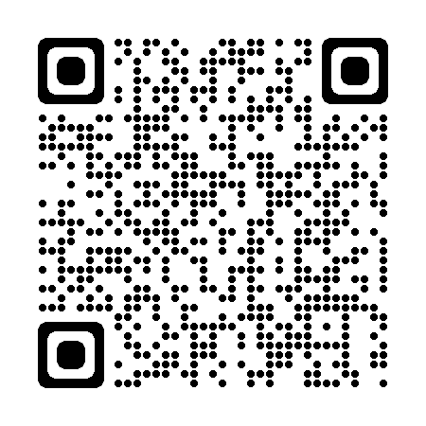
Alcohol Review Committee (ARC)
The purpose of this committee is to work in collaboration with the required City of Savannah (COS) employees and outside agencies to provide individualized duties, so the alcohol application process is more efficient.
The Alcohol Review Committee meetings will develop a streamlined process with COS and outside employees involved. This process will ensure the required documents are recommended for approval by The Alcohol Review Committee before a City Council date is provided to the applicant.
The last meeting in 2023 is scheduled for December 6th, 2023, to be approved for council on Jan 11, 2024.

Slide 11
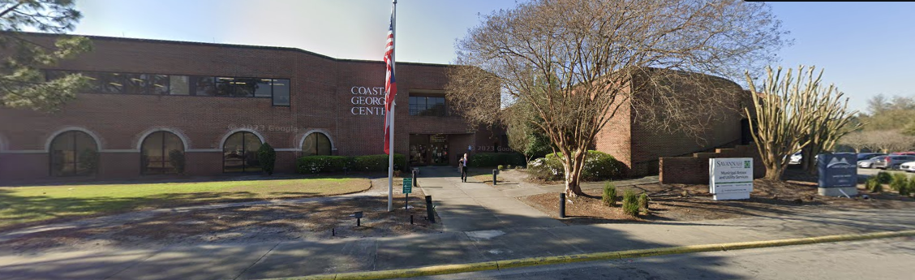
2024 QUARTERLY MEETINGS
Quarterly Sessions will be held at Coastal Georgia Center Auditorium (305 Fahm St).
2024 Meetings:
Jan 24, 2024-6-8pm
March 6,2024- 6-8pm

Slide 12

QUESTIONS

