Slide 1


Alcohol Revision
Implementation Plan

Slide 2
Alcohol Beverage Ordinance
Approved Revisions ( Jan 2023)
Georgia Legislative O.C.G.A.
O.C.G.A § 3-3-11: Section 6- Code Section 6-1213 ( c) 1-7
O.C.G.A § 3-15-2:- Section 7 - Code Section 6-1209 (t) 1-5
Home Delivery of alcoholic beverages shall not be permitted within corporate limits of The City of Savannah ( Section 2 – 6-1205 (d) )
Local Revisions
Bring your own Bottle “BYOB”- Section 8 – Code Section 1209 (u)(1) (2)
Selling, Serving or Dispensing alcoholic beverages through Windows or Doors: Section 5- Code Section 6-1212 (c)
Alcohol Beverage Compliance Unit – Mandatory Administrative Meetings: Section 11- Code Section 6-1210 (d) (1-5)
Alcohol Review Committee: Section 12- Code Section 6-1205 (d) (1) (2)
Armed Security Guards: Section 9 –Code Section 6-1209 (v) (1 a-c) (2) (3)
Alcohol License Waiting Periods- Section 3- Code section 6-1207 (b) (11) Section 4- Code Section 6-1207 (e) (1)(2)
Transitional Permit (Class K ) – Section 10- Code Section 6-1209 (w) ( 1-4)
Sever Training Permit – Section 13- Code Section 6-1215 (a)
Amended Language – Section 2 (6-1205 (a) and (c ) - adding permit/s
Fee Changes – Revenue Ordinance
Education & Outreach- Policy (SOP)

Slide 3
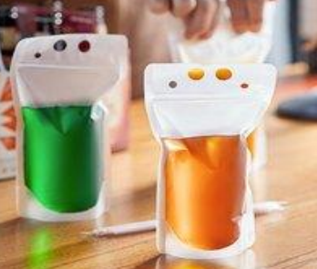
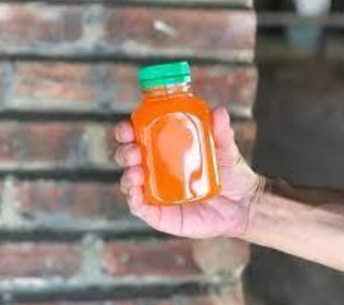
Distilled Spirits Take-Out w/ Meal
O.C.G.A § 3-3-11
Section 6- Code Section 6-1213 ( c) 1-7
Purpose
Permit Retail Consumption Dealers (Restaurants with on-premises licenses) to sell distilled spirits for off-premises consumption in approved containers with the purchase of a meal.
Examples of approved containers:
Licensee must brand each approved container with current licensed establishment name
The container must be durable, leakproof, and sealable.
Containers shall be sealed in such a way to prevent reopening without visible evidence that the seal was removed or broken.
The container shall be sealed with a tamper-evident secure cap or lid. The cap or lid shall not have sipping holes or holes designed for straws
Container with a snap on cap that has a tail band or security ring (similar to a gallon of milk).
Screw caps/tops that break the link when unscrewed (similar to the cap on a 2 liter of soda or a water bottle).
Cork or plug with a foil heat seal (similar to a wine bottle).
Crown capped glass bottles (similar to a beer bottle).
Container with a shrink band or shrink wrap seal over the screw cap.
Heat-sealed closures over sealed caps.
Take out drink carrier bag with a permanent closure adhesive or permanent heat-sealed strip
.

Slide 4
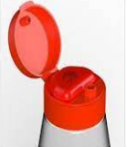
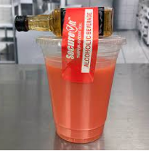
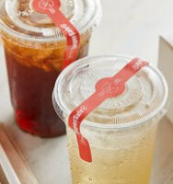
Distilled Spirits Take-Out w/ Meal
State Law: O.C.G.A § 3-3-11
Section 6- Code Section 6-1213 ( c) 1-7
Examples of Non- approved containers:
Containers with a cap or lid that provides no visible evidence when it has been opened and/or breached.
Containers containing tamper-evident tape without a tamper-evident cap or lid.
Containers with induction seals without a tamper-evident cap or lid.
Containers with straws, drink holes, or other openings.
Containers with flip top lids or caps with or without a seal liner.

Slide 5
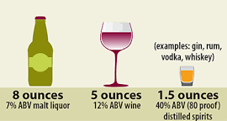
Alcoholic Beverage Tastings
O.C.G.A § 3-15-2
Section 7 - Code Section 6-1209 (t) 1-5
Purpose
Permit Class D (Retail Package Stores) and Class E (Convenience, Grocery Stores) to provide tasting events of distilled spirits, malt beverages and wine. This code section will repeal and replace Class H (Samples), in the current ABO.
All tasting events must abide by the following:
Must receive a permit from the City’s Revenue Department 14 days prior to event
New charge of $50.00 per event
Maximum size per sample is 8 oz of malt beverage, 5 oz of wine and 1.5 oz of distilled spirits
Only conduct 52 tasting per calendar year with 14-day prior notification to the City’s Revenue Department
May last only 4 hours
May only serve one type of alcoholic beverage, either malt beverage, wine, or distilled spirits. However, more than one brand of each type of alcoholic beverage may be offered, so long as no more than four packages are open at one time
Not permitted in the Alcohol Density Overlay Districts

Slide 6
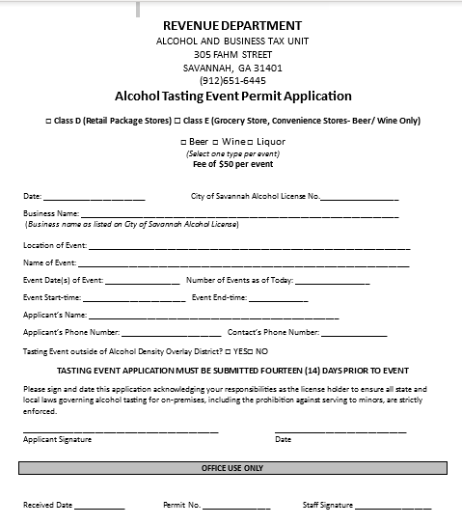

Tasting Event Permit Application

Slide 7
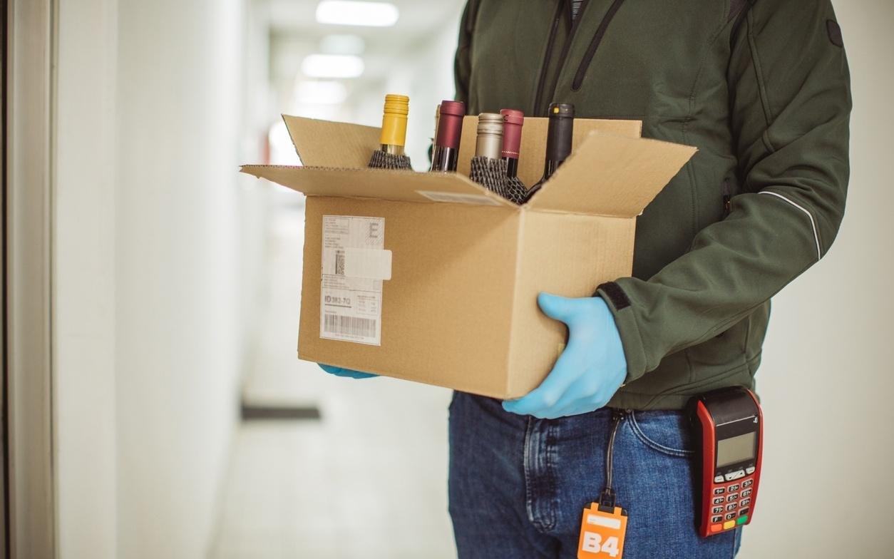
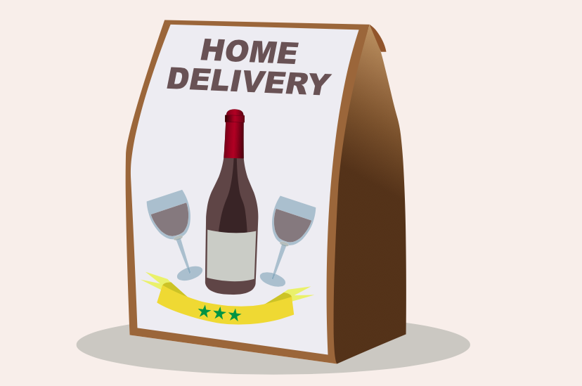
Packaged Alcohol Home Delivery
O.C.G.A § 3-3-10
Home Delivery of alcoholic beverages shall not be permitted within corporate limits of The City of Savannah ( Section 2 – 6-1205 (d) )

Slide 8

Bring Your Own Bottle “BYOB”
Section 8 – Code Section 1209 (u)(1) (2)
Purpose
Reinstate provisions of the previous ordinance pertaining to non-licensed alcohol beverage establishments who are allowing BYOB.
It shall be unlawful for the operator of any establishment that does not possess a license or permit issued under this article to serve, sell or keep for sale alcoholic beverages including unlicensed private clubs, public establishments, or places of business to allow any person to bring, keep, dispense, or sell any alcoholic beverages on said premises for use of consumption on premises
It shall be unlawful for any person to bring, pour, or serve his/her own alcoholic beverage (“brown bagging”) into any non-licensed establishment.

Slide 9
Alcohol Beverage Compliance (ABC) Unit
Administrative Meetings
Section 11- Code Section 6-1210 (d) (1-5)
Purpose
Require the appearance of the Alcohol Licensee or Responsible Party at the Administrative Meetings to discuss public safety plans along with policies and procedures after one or more violations have occurred at the establishment against the current alcohol ordinance, to include nuisance and public safety violations.
Definition
An Administrative Meeting is held to establish a corrective action plan with the Licensee and/or Responsible Party to seek compliance with the alcohol ordinance. The Administrative Meeting has no bearing on court proceedings, however attendance from the Licensee and/or Responsible Party is mandatory.
Failure to attend Administrative Meetings will result in subpoena issued to licensee or responsible party to appear in Recorder’s Court and/or Show Cause Hearing.

Slide 10
Armed Security Guards
Section 9 –Code Section 6-1209 (v) (1 a-c) (2) (3)
Purpose
Require all armed security guards working either directly for the alcohol establishment or contracted by the establishment to complete a background check through the SPD.
All private armed security businesses that furnish security services to establishments licensed to sell alcoholic beverages shall conduct a complete and thorough background investigation of all employees carrying weapons. For each such employee, the private security company shall maintain a copy of the background investigation, which shall be furnished to any representative of the SPD upon demand.
Licensee must inform the ABC Staff in writing within 30 days if any armed security guards of the licensee or establishment is convicted of a felony or any crime involving the illegal use, carrying, or possession of a dangerous weapon or any crime involving moral turpitude.

Slide 11
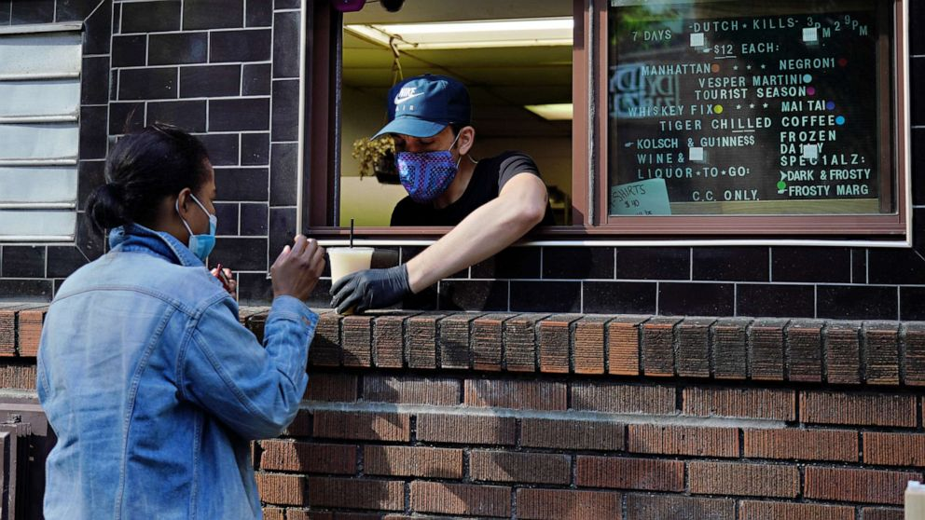
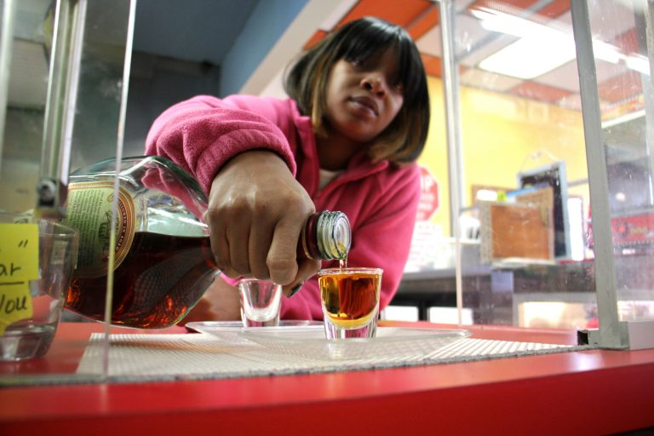
Selling, Serving or Dispensing Alcoholic Beverages Through Windows or Doors
Section 5- Code Section 6-1212 (c)
Purpose
With the exception of Class D ( Package stores) license holders, no licensee may sell or permit the sale or dispensation of alcoholic beverages through windows, doors, or other openings to sidewalks, parking lots, or to any other area outside the licensed premises, excluding approved adjacent patios.
*The City’s Festival Ordinance shall pre-empt the above restrictions in some instances.

Slide 12
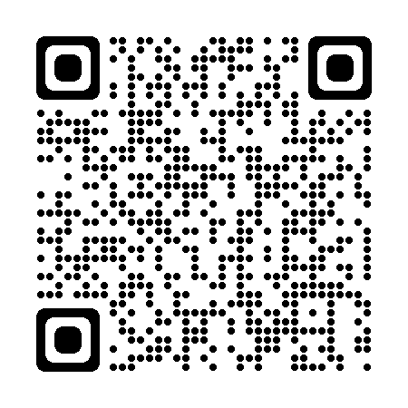
Alcohol Review Committee
Section 12- Code Section 6-1205 (d) (1) (2)
Purpose
Establish Alcohol Review Committee (ARC) to collaborate with City staff and outside agencies involved in the alcohol licensure process to improve efficiency of the application process.
Streamline process with City staff and outside agencies involved.
Ensure all regulatory requirements are met prior to consideration by City Council.
Proposed Committee Representatives
ABC Unit
Code Compliance
Clerk of Council
City Manager’s Administrative Office
Fire Marshal’s Office
State Departments of Public Health & Agriculture
City of Savannah Department of Revenue
Human Services
Planning, Zoning and Urban Design
Development Services
DPH

Slide 13
Alcohol License Waiting Periods
Section 3- Code Section 6-1207 (b)(11)
Section 4- Code Section 6-1207 (e) (1 a-b)(2)
Waiting Periods (Revocation) Proposed Revisions:
When any license is revoked as provided under this article, no further license shall be issued to such license holder for a period of 24 months from the date of revocation.
Upon two license revocations for a specific premises within a 24-month period, no further license shall be issued for the subject premises to any person, firm, or corporation at such location for a period of six months from the date of the most recent revocation.
Waiting periods (Denials) Proposed New Language:
When a license is denied by the Mayor and Aldermen pursuant to the provisions of this Article, no license shall be issued to such ABL Applicant or Responsible ABL Applicant for the premises subject to the ABL denied application for a period of twelve (12) months from the date of denial.
Waiting Periods (Surrender) Repeal and Replace Language:
For occasions on which the applicant, manager, or any person with a financial interest in the establishment has voluntarily surrendered an alcoholic beverage license issued by the city, no license shall be issued to such person at subject location for a period of twelve (12) months immediately following the surrender. Licensees may surrender 14 days prior to revocation proceedings.

Slide 14
Transitional Permit
Class K-
Section 10- Code Section 6-1209 (w) ( 1-4)
Purpose
Transitional permit - Class C licensees shall obtain if they suspend food service, particularly during night or early morning hours.
Any Class C licensee operating under such model, whether partially or fully suspending food service, shall be required to obtain a transitional permit. Additional factors indicative of transitional activity include, but are not limited to, charging an entry fee during certain, but not all, times, utilizing security staff at certain, but not all, times, and otherwise operating as a restaurant but transitioning to a bar during certain hours, particularly at night, as the terms “restaurant” and “bar” are commonly understood.
Required for existing and new alcohol establishments seeking transition privileges.
Any existing establishment operating without an Alcohol Transitional Permit will be cited under code section 6-1209(w)(1-4).
The following guidelines will be permitted during the transitional phase:
Cease or modify food sales
Entry fee
Employment of Security Staff (armed/unarmed)
Surveillance Cameras
The Transitional Permit will require:
No one under 21 years of age allowed on premise during transitional hours.
Alcohol Transitional Permit Application along with payment of $1,500 dollars paid to the City’s Revenue Department
Only current ABL/Responsible ABL applicants can apply for Transitional Permit
Additional Public Safety Plan must be turned into the SPD’s Alcohol Beverage Compliance (ABC) unit at the time of permit request

Slide 15
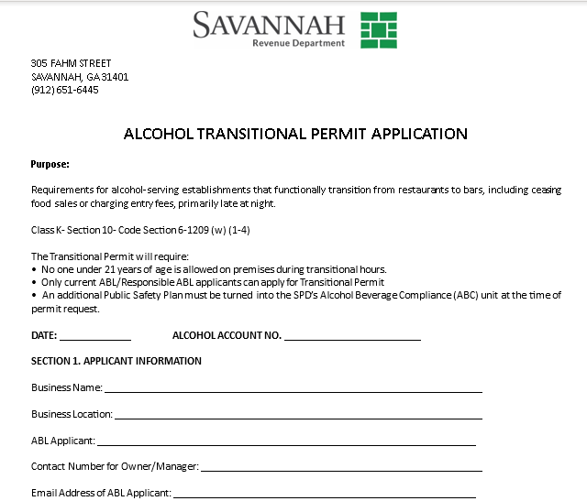
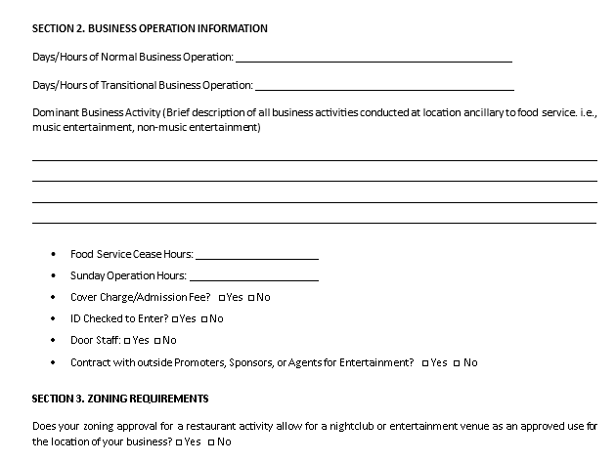
Transitional Permit Application

Slide 16
Server Permit Training Card
Code Section 6-1215(a)
Changes to the Ordinance reflect that the Server Training Permit will be a simplified online application process, as follows:
1. Alcohol server applicants will visit the City’s website, where they will register, view an online standardized alcohol awareness training course administered by the City, and complete an online alcohol awareness assessment to include human trafficking course
2. Upon successful completion of the assessment, applicants will submit the training certification.
3. The City will then issue to the server a Server Training Permit Card, which will be valid for five years. At the end of the five years, additional training will be required to renew.
Servers will have until January 1, 2024, to obtain their permit.

Slide 17
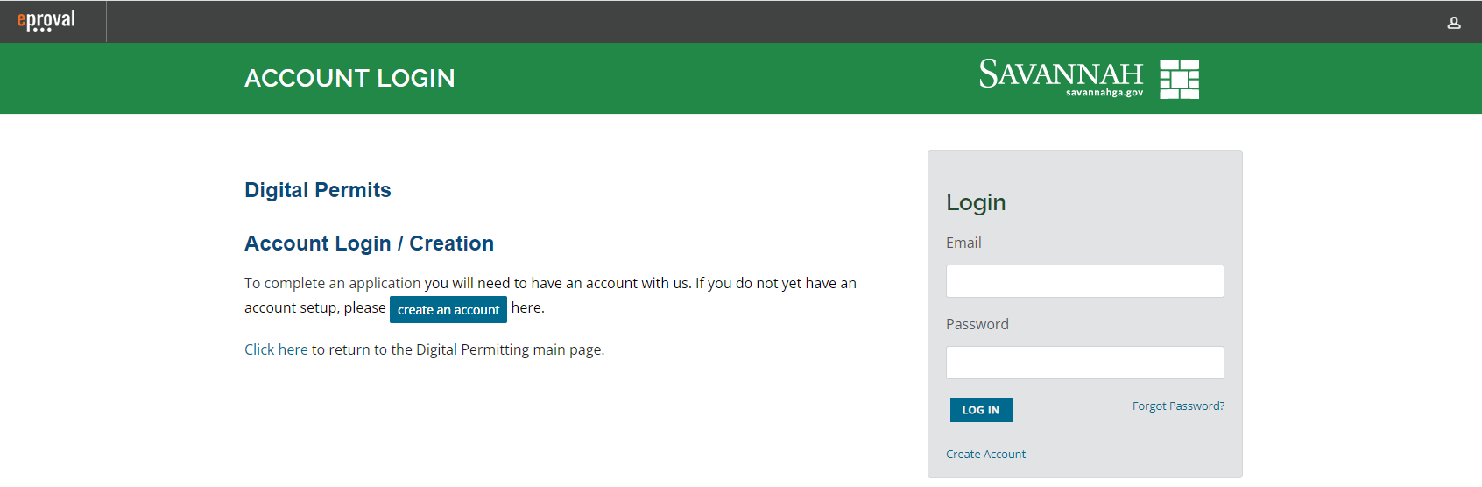
Alcohol Server Training
Permit Process
No Cost

Slide 18
Alcohol Server Training Outline
The Effects of Alcohol
Subsections:
Behavior Cues (2 questions)
Intoxication Rate Factors (2 Questions)
Blood alcohol Content(BAC) – 1 question and scenario)
Local Law
Subsections:
Sunday Sales ( 2 questions)
Server Training (2 questions)
Lawful presence of persons under the age of 21 (1 question and scenario)
Ga Law
Subsections:
Ages to consume/pour/sell/serve. (2 questions )
DUI /DWI Limit (over/under 21)- ( 2 questions)
Dramshop Laws (1 question and scenario)
ID
Subsections:
Commonly used ID (2 questions)
Unacceptable ID (2 Questions)
Steps to follow to Check ID ( 1 question and scenario)
Overconsumption
Subsections:
Cut off Guidelines (2 questions)
Safe- selling guidelines(2 questions)
Underage warning signs ( 1 question and scenario)
Human Trafficking
Signs and definitions
Support and resources

Slide 19
Fee Changes
Revenue Ordinance
Revenue Ordinance Revisions:
Alcohol Review Committee Application: $ 50.00 (new)
Tasting Event Permit per event: $ 50.00 (new)
Alcohol Transitional Permit Application $ 1,500 dollars (new)
Discount for sole proprietor Veteran establishments to comply with State Law: 40%

Slide 20
Education and Outreach
Convene quarterly meetings to:
  Assist new, existing, and future alcohol applicants understand the relevant rules and regulations pertaining to their business and alcohol
  Provide updates to the Alcohol Beverage Ordinance and current overlays
  Provide an opportunity to hear from the industry on concerns
  Host seminars on new trends
  Discuss revisions to regulations and/or policies
  Questions? Email jblalock@savannahga.gov.

